Slide 1



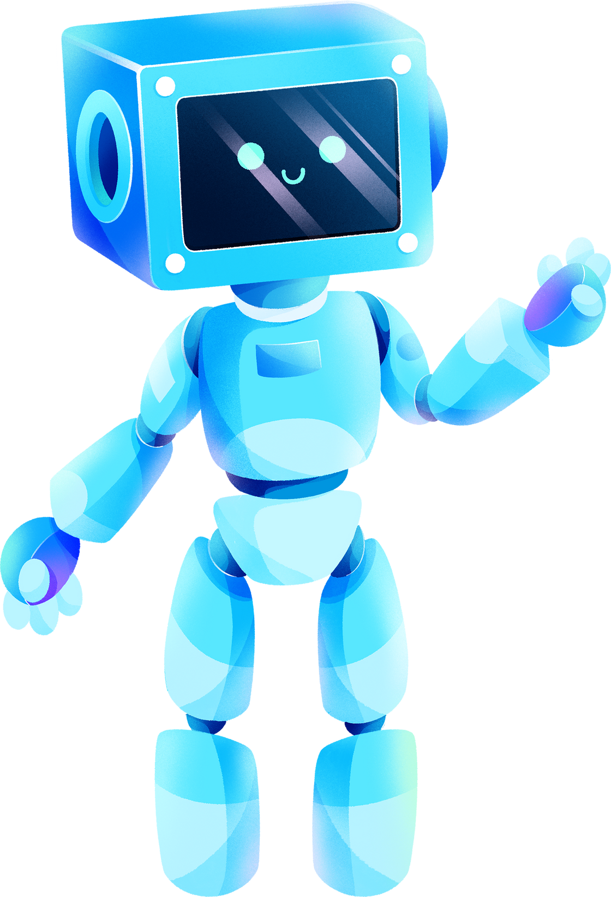

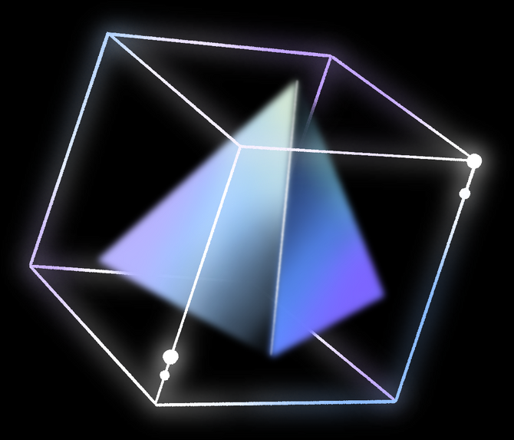
ROBOTICS AND KINEMATICS DIGITAL ASSIGNMENT-2

Slide 2



TEAM MEMBERS
TANISHA-22BRS1009 ABHINAV-22BRS1081 BHAMINEE-22BRS1278 RIMMI-22BRS1288

Slide 3


PROBLEM STATEMENT
Implement Node MCU based motion planning with shortest distance criteria and obstacle detection capability.

Slide 4

INTRODUCTION
THE PROJECT INVOLVES DESIGNING AND IMPLEMENTING A MOTION PLANNING SYSTEM USING A NODEMCU MICROCONTROLLER. THE GOAL IS TO DEVELOP AN INTELLIGENT SYSTEM CAPABLE OF NAVIGATING FROM A START POINT TO A TARGET DESTINATION WHILE ENSURING THAT IT FOLLOWS THE SHORTEST PATH AND AVOIDS OBSTACLES.
01
02
03
04
Shortest Path Planning: The system calculates the most efficient path to the destination using algorithms such as Dijkstra's or A* to optimize travel distance or time.
Obstacle Detection: Equipped with sensors like ultrasonic or infrared, the system continuously scans its environment for obstacles and dynamically adjusts the path to avoid collisions.
Real-Time Processing: The NodeMCU handles the real-time calculation of path adjustments as it navigates, enabling autonomous motion in unpredictable environments.
NodeMCU: NodeMCU is a low-cost, open-source IoT platform based on the ESP8266 Wi-Fi module. It provides flexibility in terms of integrating with sensors and modules, allowing wireless communication for monitoring and control.

Slide 5
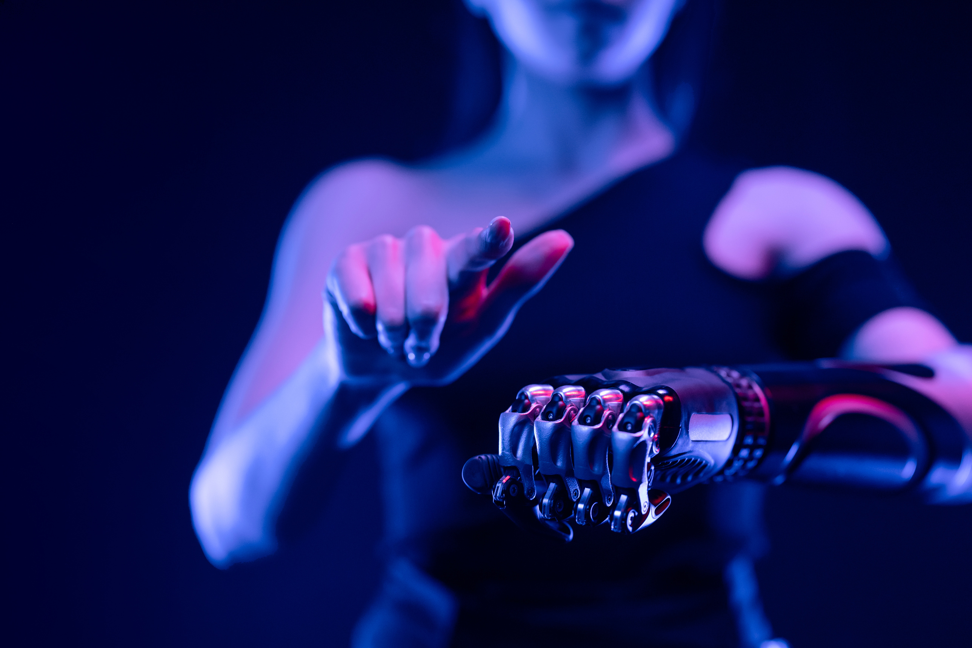

PROJECT STRUCTURE
1. Chassis (Robot Body)
Material: The base of the robot is typically made of a lightweight material such as acrylic or aluminum.
Wheels: The robot is fitted with 2 or 4 wheels, connected to motors for movement. For a 2-wheel design, a castor wheel is added for balance.
2. Motors
DC Motors / Servo Motors: These motors are used to drive the wheels, allowing forward and backward movement, as well as turning left or right.
Motor Driver (L298N): This module controls the motor's speed and direction based on input from the NodeMCU.
3. NodeMCU (ESP8266/ESP32)
The central processing unit of the robot, which handles sensor input and movement control. It processes obstacle detection, shortest path algorithms, and controls motor movement.
Wi-Fi Connectivity: NodeMCU can be connected wirelessly to a user interface for remote monitoring or control.

Slide 6
PROJECT STRUCTURE
4. Obstacle Detection Sensors
Ultrasonic Sensor (HC-SR04): Placed at the front and/or sides of the robot to measure distances to obstacles. Multiple sensors can be used for 360° detection.
Infrared (IR) Sensors: These can also be used for short-range obstacle detection or for detecting changes in surface or lines for path planning.
5. Battery and Power Supply
A Lithium Polymer (Li-Po) battery or Lithium-ion (Li-ion) battery is used to power the robot and its components, ensuring portability.
Power Management: Voltage regulators are used to ensure the NodeMCU and other components receive the appropriate voltage.
6. Path Planning Algorithm
The NodeMCU runs a path planning algorithm like Dijkstra’s or A* to calculate the shortest distance to the target while avoiding obstacles.

Slide 7

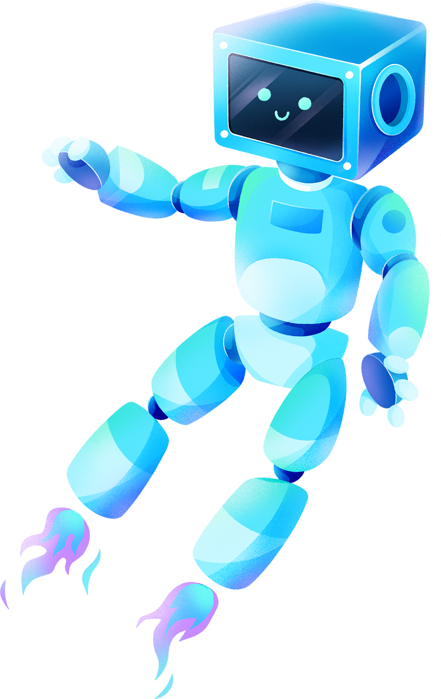




SYSTEM ARCHITECTURE
The basic workflow of the robot is:
Input from Sensors → Obstacle detected by ultrasonic/IR sensors.
Processing by NodeMCU → Shortest path algorithm computes the route and sends motor control signals.
Actuation by Motors → The robot moves forward, turns, or stops based on the processed information.
This robotic structure provides a reliable system for autonomous navigation, balancing path efficiency with safety through real-time obstacle detection.

Slide 8
IMPLEMENTATION
The implementation of this project involves several steps, starting from the hardware setup to the software development and integration. Here’s a detailed guide on how to implement the project:
1. Hardware Setup
a. Chassis and Motors
Assemble the robot’s body using a chassis, attaching the DC motors to the wheels.
Connect the motors to the motor driver (L298N), which will be used to control their speed and direction. The motor driver is essential for interfacing between the low-voltage signals from the NodeMCU and the high-power motors.
Ensure the wheels are securely mounted and can rotate freely.
b. NodeMCU (ESP8266/ESP32)
Mount the NodeMCU on the chassis. This board will act as the "brain" of the robot.
Connect the motor driver to the NodeMCU to allow control of the motors. The IN1, IN2, IN3, IN4 pins of the motor driver are connected to the respective GPIO pins of the NodeMCU to control motor directions.

Slide 9
IMPLEMENTATION
c. Obstacle Detection Sensors
Ultrasonic sensors (HC-SR04) are used for obstacle detection. Place these sensors at the front (and optionally on the sides) of the robot to measure distances to obstacles.
Connect the VCC, GND, Trigger, and Echo pins of the ultrasonic sensor to the NodeMCU. The Trigger and Echo pins are used for measuring distance by calculating the time taken for sound waves to bounce back from an obstacle.
d. Power Supply
Use a Li-Po/Li-ion battery to power both the NodeMCU and the motors. Connect a voltage regulator if necessary to ensure proper voltage levels for the NodeMCU (3.3V) and the motors (usually 6-12V).
Make sure all components are securely powered and the connections are stable.
2. Software Development
a. Programming Environment
Use Arduino IDE for writing and uploading the code to the NodeMCU.
Install the necessary libraries for sensor control and Wi-Fi communication:
Ultrasonic Sensor Library for obstacle detection.
Motor Control Library for driving the motors.
WiFi Library if remote control or monitoring is needed.

Slide 10
IMPLEMENTATION
b. Path Planning Algorithm (Shortest Distance Calculation)
Implement a shortest path algorithm like Dijkstra's or A* in the code. The algorithm will continuously compute the shortest path to the target, updating in real-time if obstacles are detected.
Dijkstra's Algorithm can be used for simple grid-based environments.
A* is more efficient in dynamic environments with obstacles, as it uses a heuristic to guide the search.
c. Obstacle Detection
d. Real-Time Navigation Logic
e. Motor Control
3. Testing and Calibration
Test the robot in different environments with obstacles placed at varying distances.
Calibrate the ultrasonic sensor thresholds to ensure that the robot reacts quickly to obstacles.
Test the path planning algorithm by setting different start and end points and ensuring the robot finds the shortest path and avoids obstacles.

Slide 11
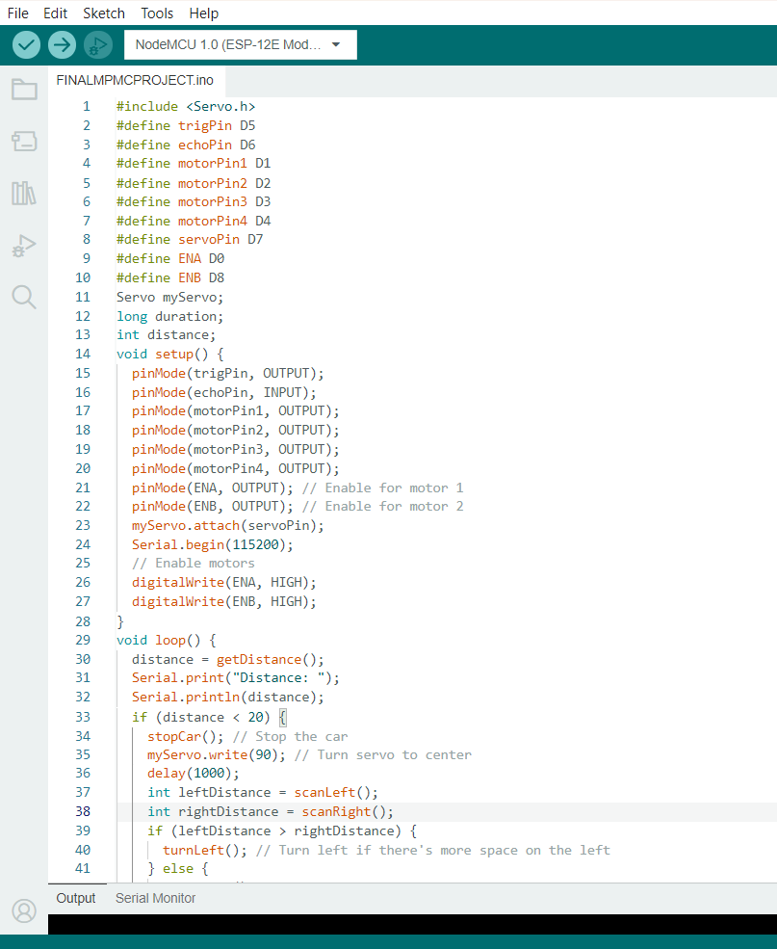
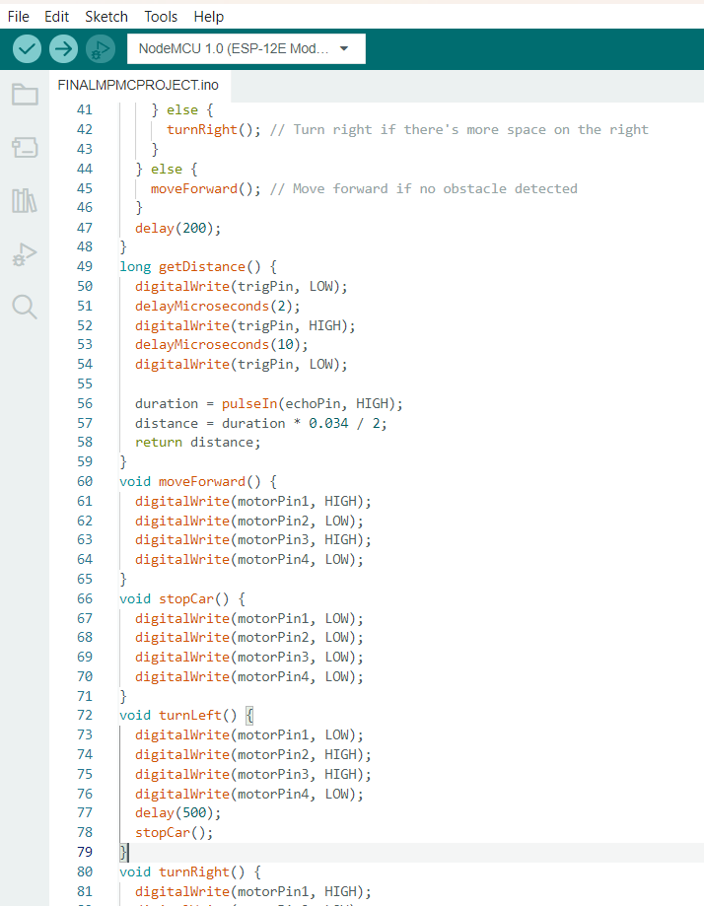
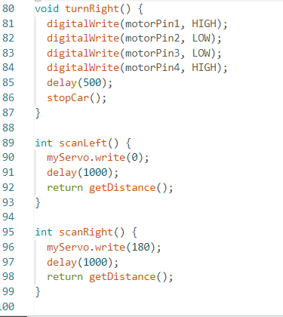
CODE:

Slide 12
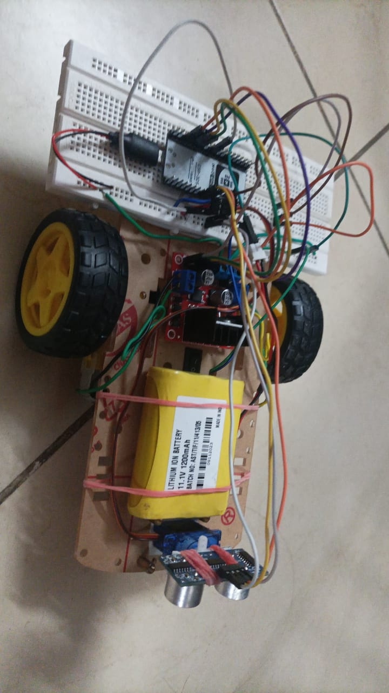

Slide 13

THANK YOU!

